Slide 1

Comprehension Toolkit
Figurative language 2
Simile and
metaphor

Slide 2

Comprehension Toolkit
Figurative language 2
Comprehension means understanding.
The best way to understand a text is to
ask yourself questions
as you read it.
The answers to some questions are easy to find, while the answers to others are more difficult to work out.

Slide 3

Comprehension Toolkit
Figurative language 1
Figurative language moves away from the straightforward, literal meaning of words.
It encourages readers to form pictures in their minds. It can add interest, energy and even rhythm to writing.

Slide 4
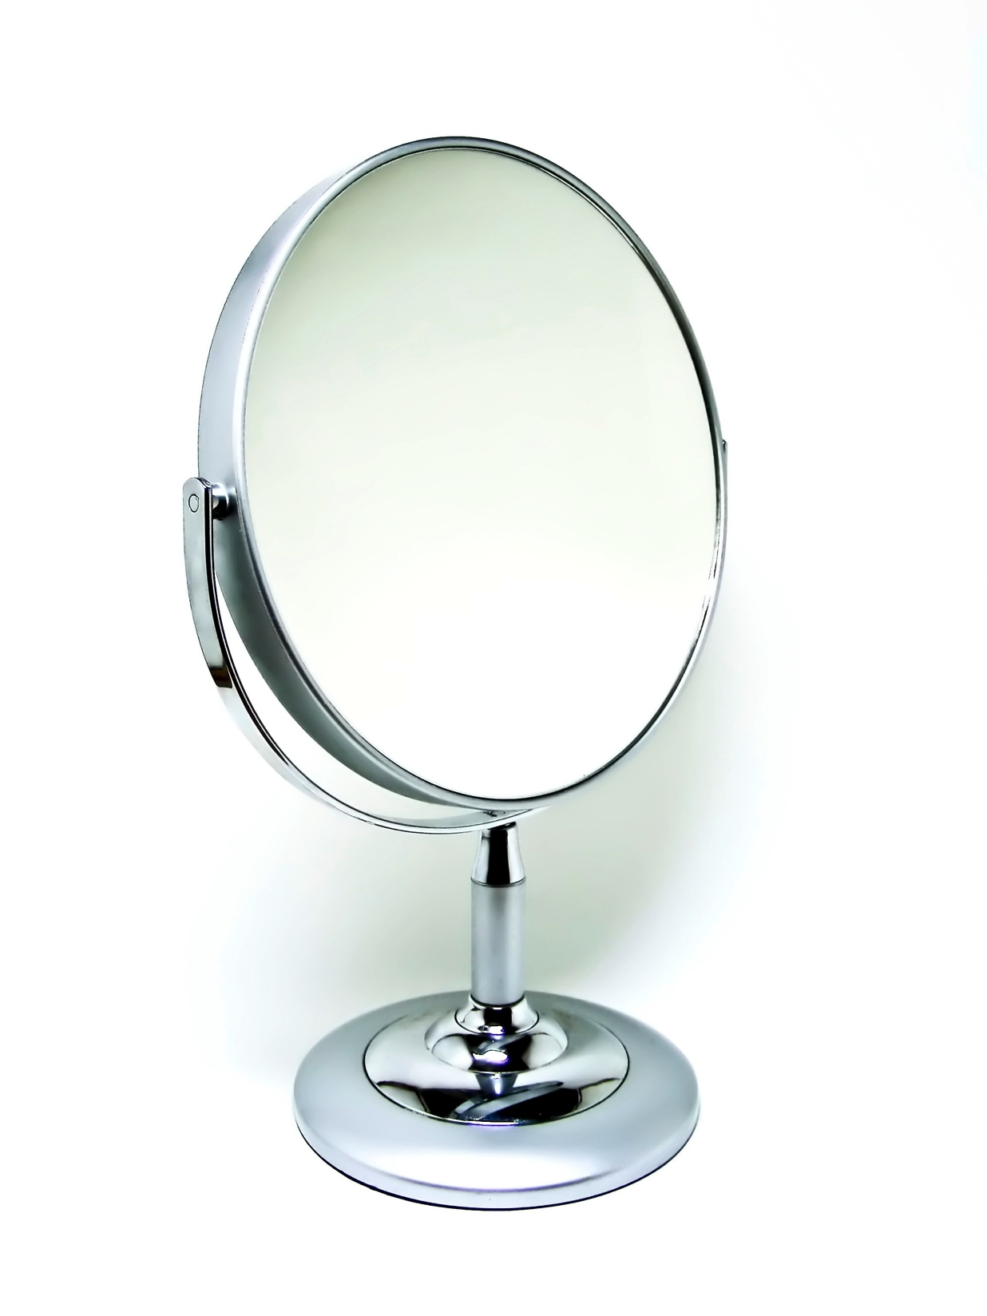
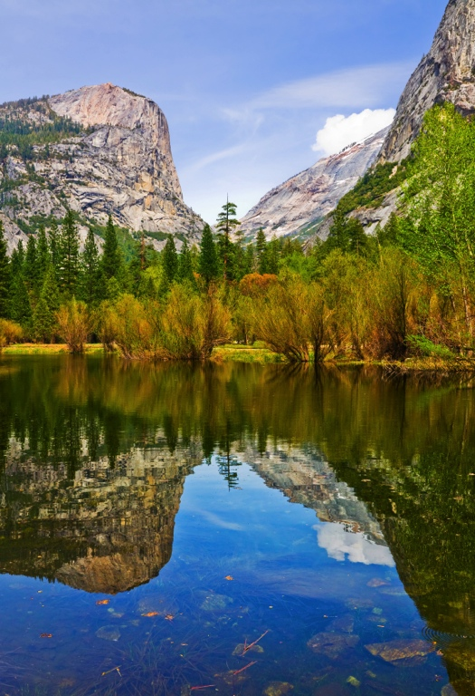
Comprehension Toolkit
Figurative language 2
A simile compares one thing to
another, using the words like or as. It usually compares two things that are quite unalike.
The surface of the lake was as smooth as a mirror.
Comparing the lake to a mirror helps you to form a mind picture of the lake’s appearance. It emphasises the stillness of the water and adds interest to the text.

Slide 5

Comprehension Toolkit
Figurative language 2
The spire at the top of the building pointed skywards like a needle.
Comparing the spire to a needle helps you to form a mind picture
of the spire’s shape. It emphasises the sharpness of the spire and
adds interest to the text.

Slide 6
Comprehension Toolkit
Figurative language 2
What is the guard being compared to?
The guard stood as still as a statue.
This simile helps you to form a mind picture
of how the guard stood.
What is the duck being compared to?
The duck looked like an overstuffed pillow.
This simile helps you form an amusing mind picture of the duck’s appearance.

Slide 7
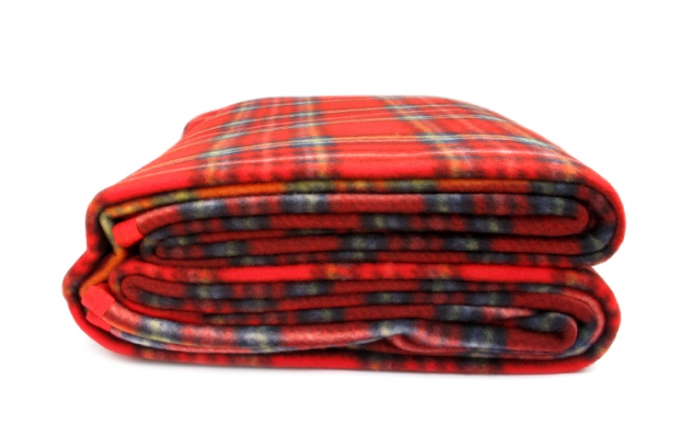
Comprehension Toolkit
Figurative language 2
A metaphor also compares one
thing to another, but does not use like or as to do so.
A metaphor can be more forceful than a simile
because the comparison is more direct.
The snow was a thick blanket on the ground.
What is the snow being compared to?
Why is this figure of speech effective?
The comparison allows you to create a more vivid picture of the scene in your mind.

Slide 8
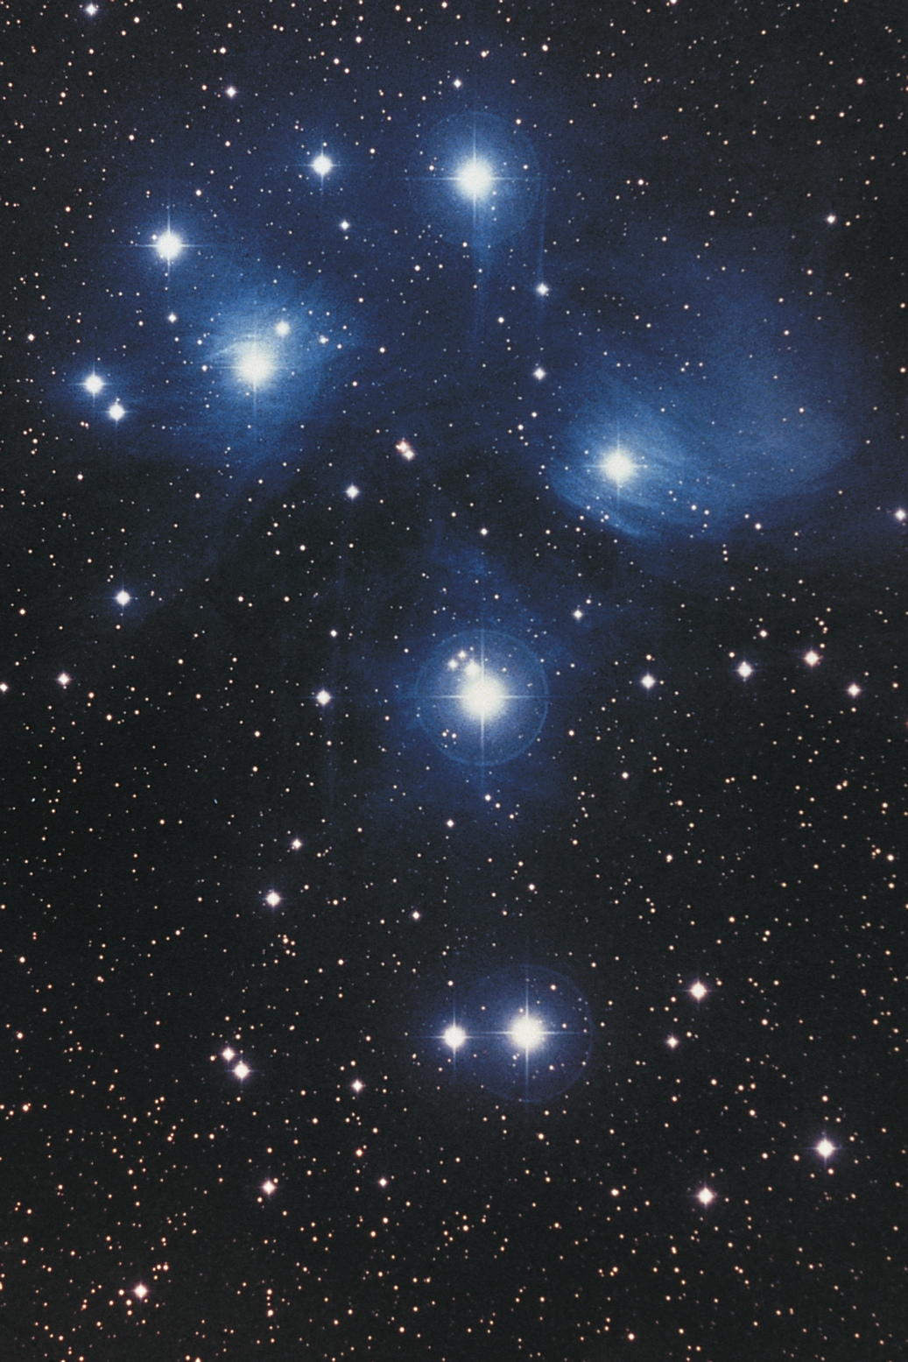
Comprehension Toolkit
Figurative language 2
The stars were glittering diamonds in the night sky.
What are the stars being compared to?
Why is this figure of speech effective?
The comparison allows you to emphasise how bright the stars were.

Slide 9
Comprehension Toolkit
Figurative language 2
The End

