Slide 1

Comprehension Toolkit
Making connections 3
Keeping track
of pronouns

Slide 2

Comprehension Toolkit
Making connections 3
Comprehension means understanding.
The best way to understand a text is to
ask yourself questions
as you read it.
The answers to some questions are easy to find, while the answers to others are more difficult to work out.

Slide 3

Comprehension Toolkit
Making connections 3
If there are two or more characters in a text and the writer uses pronouns to refer to them, it can be difficult to work out which pronoun refers to which character.
To properly understand a text, keep track of pronouns by connecting them to the
nouns they refer to.

Slide 4
Comprehension Toolkit
Making connections 3
Which nouns and pronouns go together?
Ella, Oliver and Noah picked up their buckets and took them to the water. Ella found a beautiful shell, which she placed in her bucket. Oliver and Noah each found a black stone. Oliver’s was smaller than Noah’s, but he didn’t mind. He thought his brother’s stone had a more interesting shape.

Slide 5
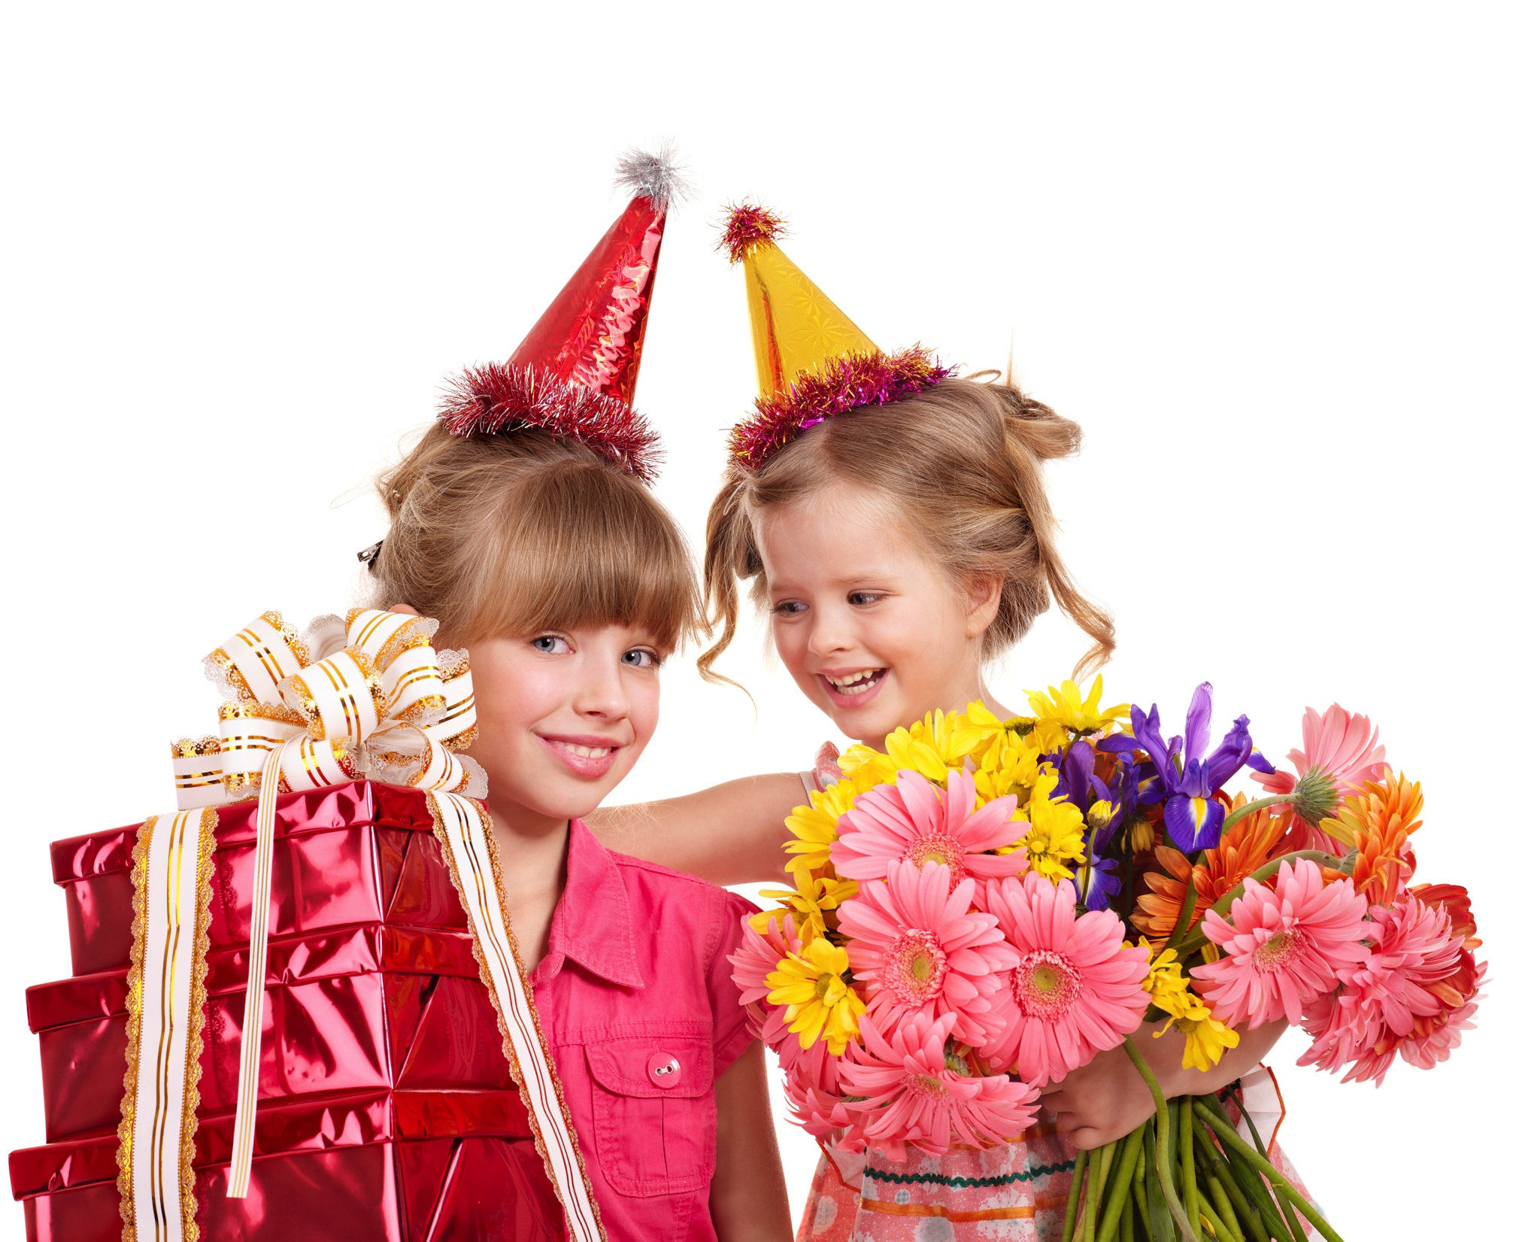
Comprehension Toolkit
Making connections 3
Which nouns and pronouns go together?
It is Chloe’s birthday and Chloe has invited some of her friends to celebrate it with her. Her friends are having a great time. All of them are wearing hats.

Slide 6
Comprehension Toolkit
Making connections 3
The End

