Slide 1

Comprehension Toolkit
Target audience
Identifying the
target audience

Slide 2

Comprehension Toolkit
Target audience
Comprehension means understanding.
The best way to understand a text is to
ask yourself questions
as you read it.
The answers to some questions are easy to find, while the answers to others are more difficult to work out.

Slide 3
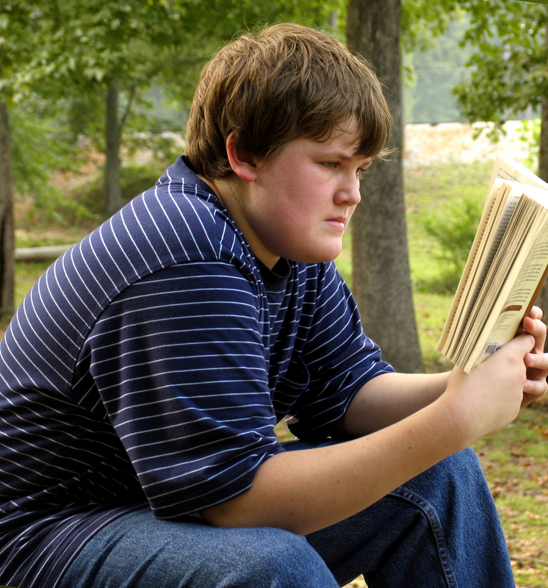
Comprehension Toolkit
Target audience
Texts may be written for a general audience or for a specific audience.
Fiction texts, such as novels, plays, movie scripts and poems, are usually written for a general audience.

Slide 4
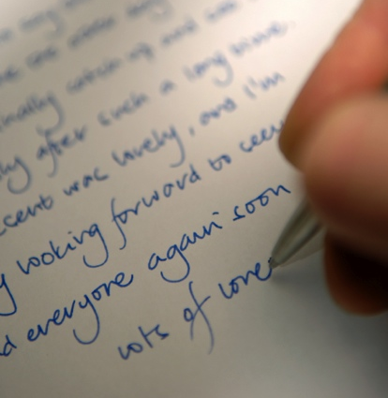
Comprehension Toolkit
Target audience
Nonfiction texts may be written for a
general audience or a specific audience.
For example, a biography is usually written for a general audience, while a letter is for a specific audience.

Slide 5

Comprehension Toolkit
Target audience
What age group is the target
audience of a text?
Texts aimed at young children generally contain:
simple vocabulary.
simple and compound sentences that are not too long.
lots of pictures.
An evil giant captured a beautiful princess and kept her in a stone tower. The princess was very sad. She missed her family and friends. Her only companions were a little bird and a tiny mouse.

Slide 6
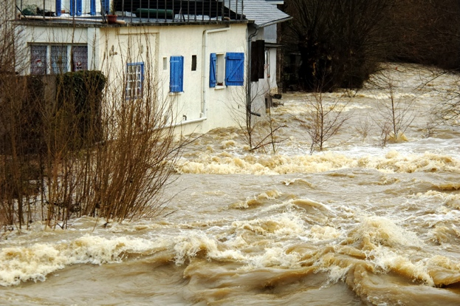
Comprehension Toolkit
Target audience
Texts aimed at an older audience generally contain:
more advanced vocabulary.
a mixture of short and long sentences.
a mixture of simple, compound and complex sentences.
I found myself in a boiling pot of enormous, foam-crested waves. I looked around and soon realised that I wasn’t moving with the water. Then I saw that
I was caught in a tangle of branches.
A procession of animals and objects — cows, fridges, cars — swept past me.

Slide 7
Comprehension Toolkit
Target audience
Who is the target audience for this text?
If you’ve enjoyed the previous Harry Potter movies, you’ll be blown away by the latest one. The characters have matured and the themes are darker, but Harry Potter fans won’t be put off by this.
This text is aimed at Harry Potter fans. How do we know?
The personal pronoun you shows that the writer is addressing people who have seen the previous Harry Potter movies and are therefore Harry Potter fans.

Slide 8
Comprehension Toolkit
Target audience
Who is the target audience for this text?
Without the use of radar, it would be impossible to guide air traffic through the world’s crowded skies. Air-traffic controllers use radar to find the positions of aircraft and to guide them to airports. RADAR is an acronym for RAdio Detection And Ranging.
This text is aimed at an older audience.
How do we know?
The writer uses advanced vocabulary and
compound and complex sentences.

Slide 9
Comprehension Toolkit
Target audience
The End

